Slide 1
Staad Pro Project
R. Swapna - 18501A0146
K. Sai Anand Vardhan - 18501A0125
Poojith Tatineni - 18501A0144
K. Chandrasekhar - 18501A0123
L. Srinivasa Rao - 18501A0127
By Team 7

Slide 2
GUIDE TO INSTALL STAAD PRO
https://drive.google.com/file/d/1FVr3V9WWdN9IYqle7GcM8BZmZY87m2Q7/view?usp=sharing

Slide 3
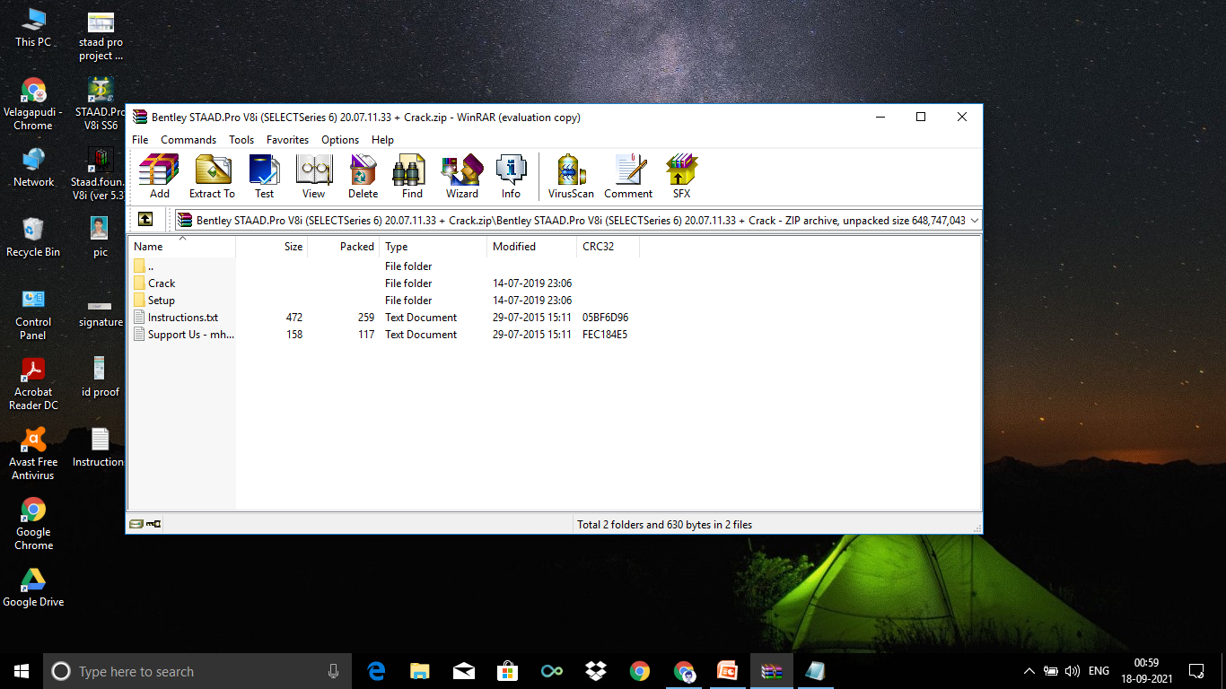

Slide 4
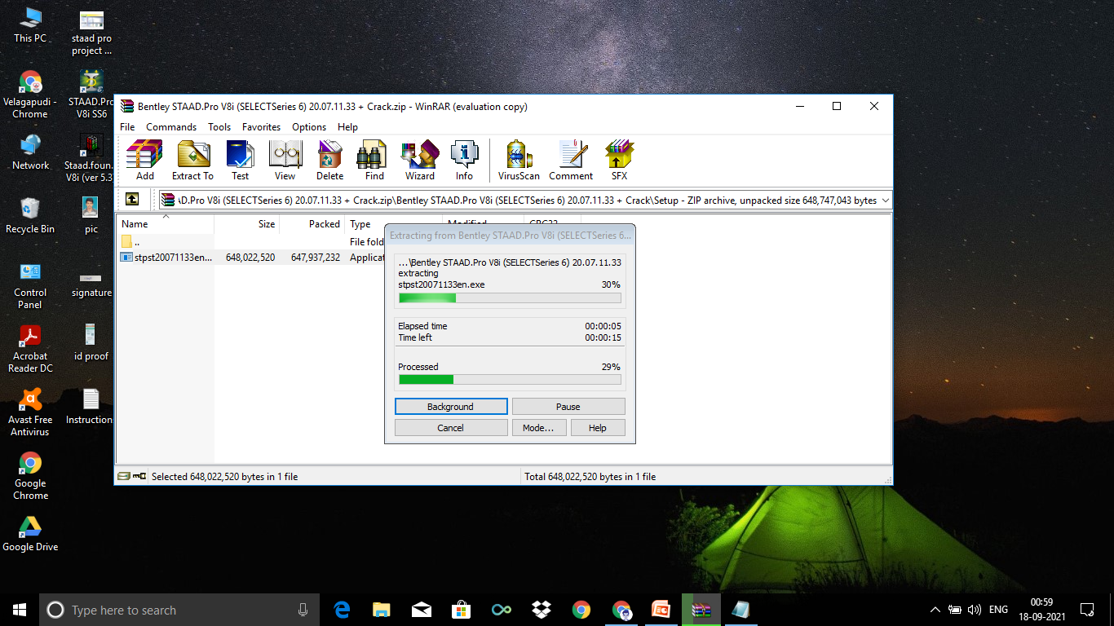

Slide 5
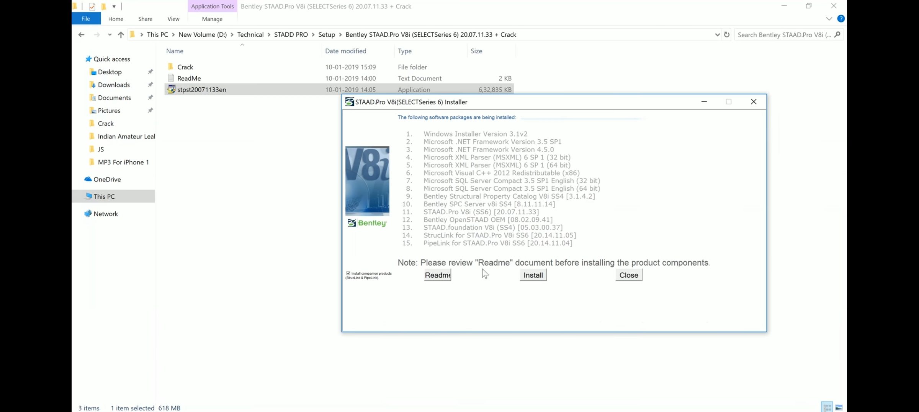

Slide 6
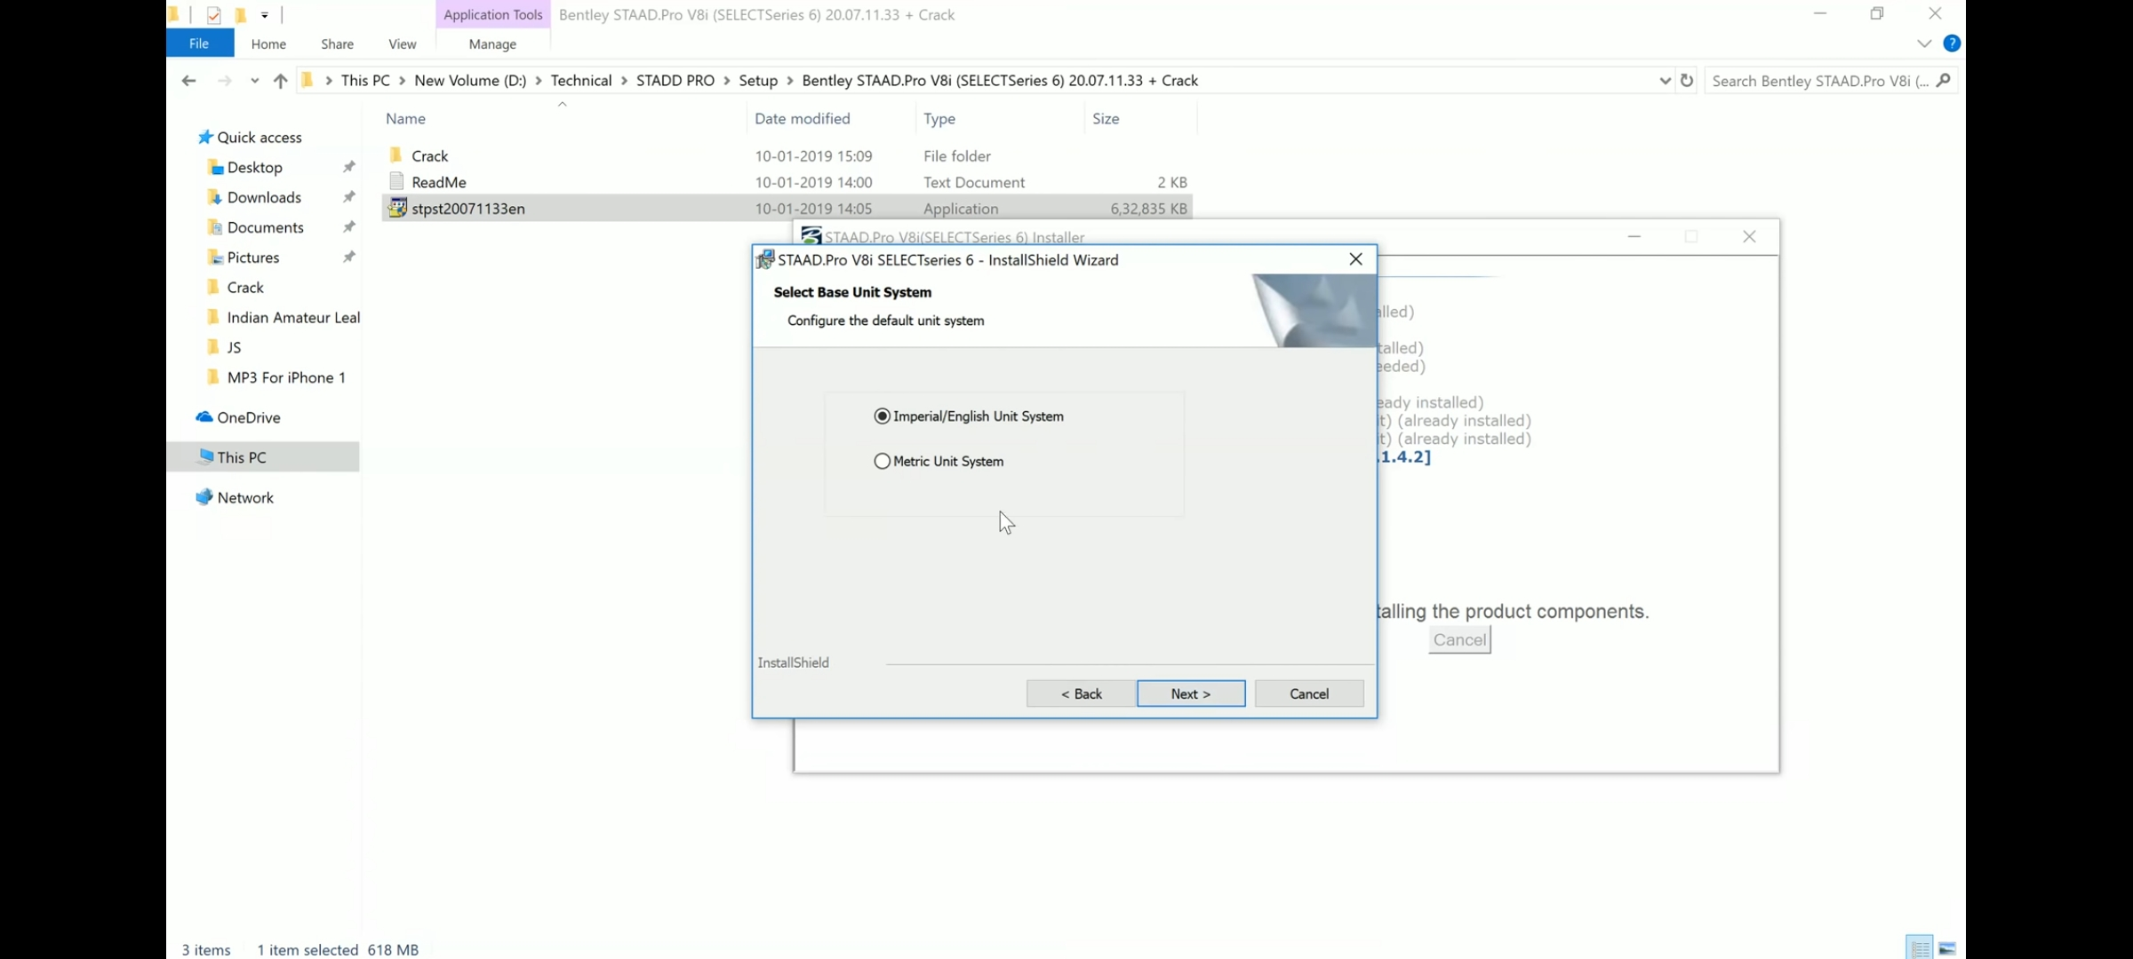

Slide 7
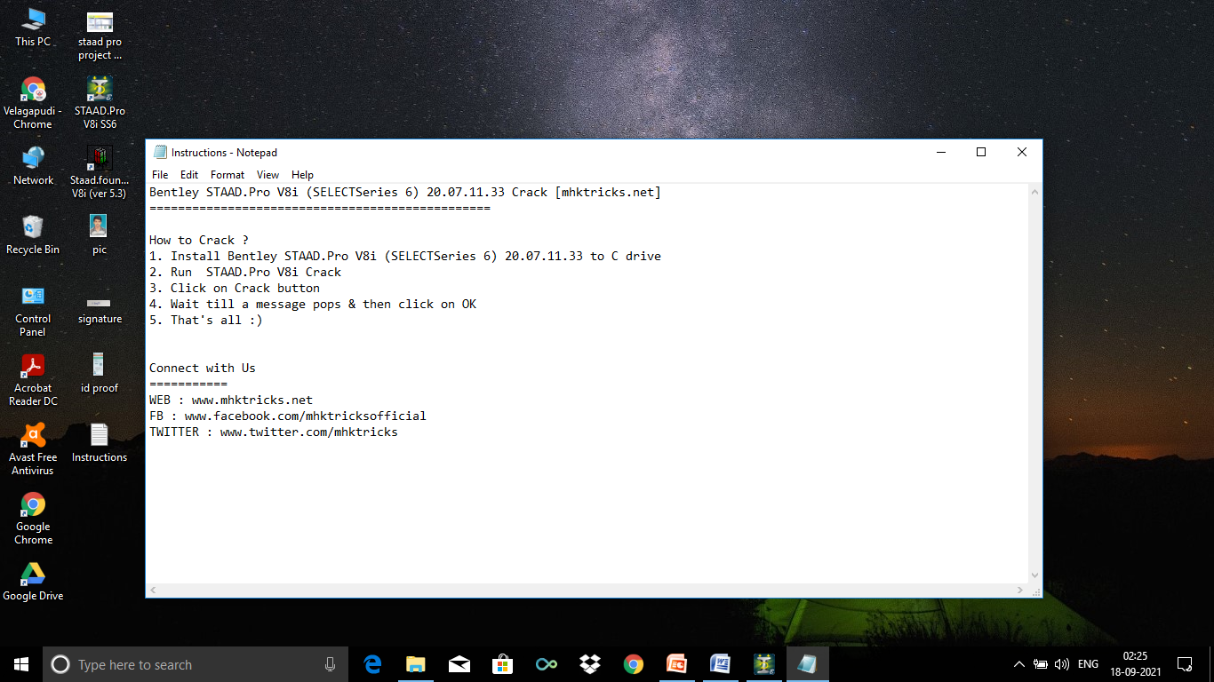

Slide 8


Slide 9
INTRODUCTION
STAAD PRO is a structural analysis design program software.
It includes a state of the art user interface, visualization tools and international design codes.
It is used for 3D model generation, analysis and multi-material design.
In built command file editor for text edits.

Slide 10
FEATURES
Customizable structural templates for model creation.
Pull down menus, floating tool bars, tool tip help as well as quick data input via spreadsheets.
Analysis
Postprocessor – Space Frame
Steel Design
Concrete Design

Slide 11
BENEFITS
Know about object oriented intuitive 2D and 3D graphic model generation.
Gain knowledge about isometric and perspective views and 3D shapes.
Able to generate graphics/text inputs.
Design concrete beams, columns, slabs as per all major international codes.

Slide 12
INTERFACE
New Project - to open new project
Open Project- to open required one
Recent files – to open recent files

Slide 13
How to create new project in staad pro [bentley]
New project
Snap node/beam
Spreadsheet method is better than grid method (snap node/beam).
Geometry => Beams =>Insert ordinates of nodes

Slide 14
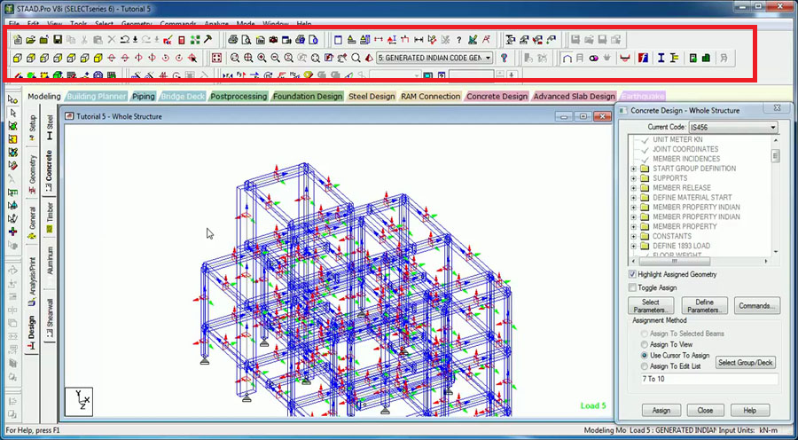
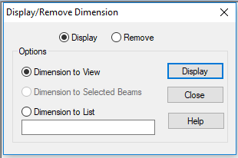
Various options in
STAAD PRO
-Dimension
-Pan
-view options
-symbols and labels
-3D rendered view

Slide 15
Load and definition option-to assign loads
Labeling loads-symbols and labels [shift +v]
Menu bar – Edit –Staad Editor
Now edit the following values:-
‘E’ - Modulus of Elasticity, Density< strength FCU (which is ‘fck’)
Check units
“Analyze/print”-“No Print”-add.
close the window-“Analyze’’-“Run analysis” or “ctrl + F5” .

Slide 16
BEAM ANALYSIS
Create a project
Set units
Sequence(on left vertical palette): Geometry=>General(=>Support=>Load & Definition)=>Analysis/print=> Analyze=>Run Analysis

Slide 17
“Snap node/beam” or spread sheet method is used to draw the beam
General→ define the properties
Select the shape and give the dimensions
Supports → to create the supports
Load & definition→ add loading type and the load value
Analysis/print→ run analysis

Slide 18
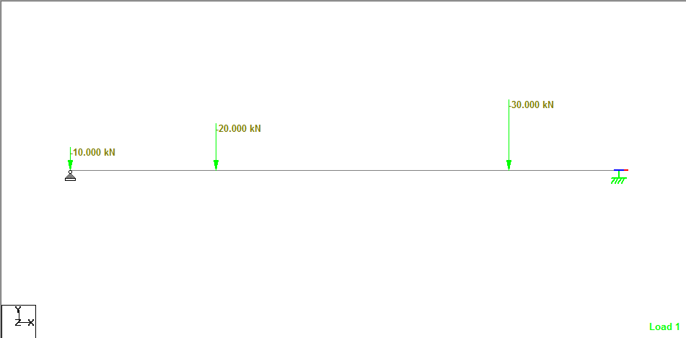
EXAMPLE 1:

Slide 19
Input:
Load=Point loads -10kN,20kN at 4m,30kN at 8m from 20kN
Supports=hinged and roller
Length=10m
fck=20N/mm^2
Beam =300*500 mm

Slide 20
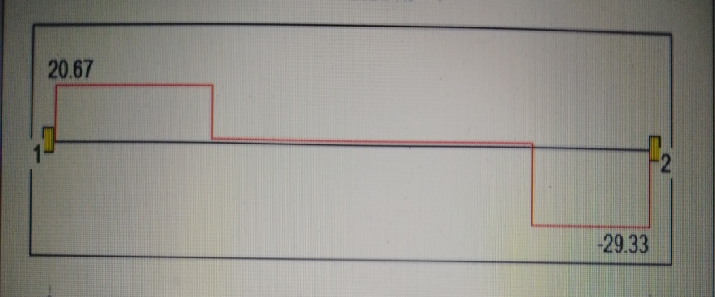
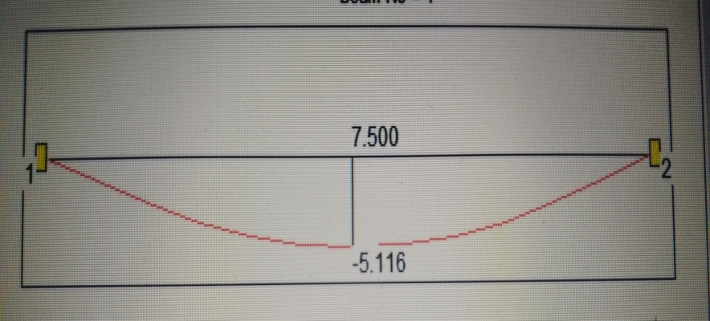
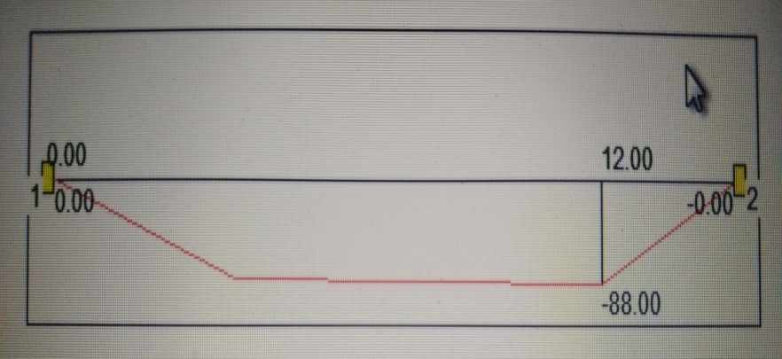
Output:
Shear force
Deflection
Bending moment

Slide 21
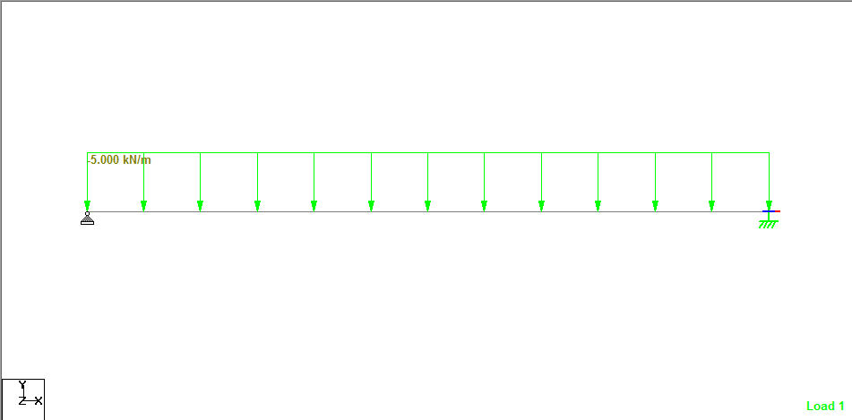
EXAMPLE:2

Slide 22
Input:
Load=udl-5kN/m
Supports=hinged and roller
Length=10m
fck=25N/mm^2
Beam =400*500 mm

Slide 23
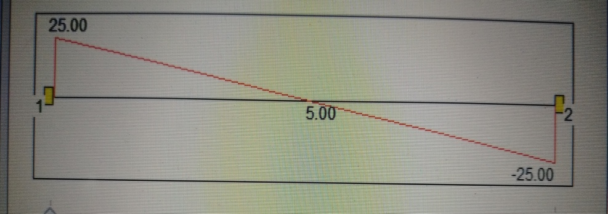
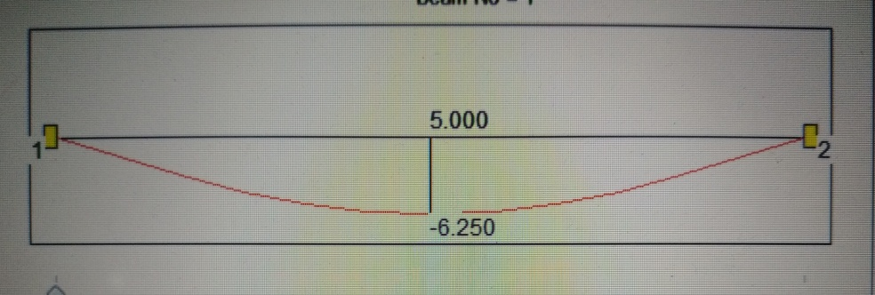
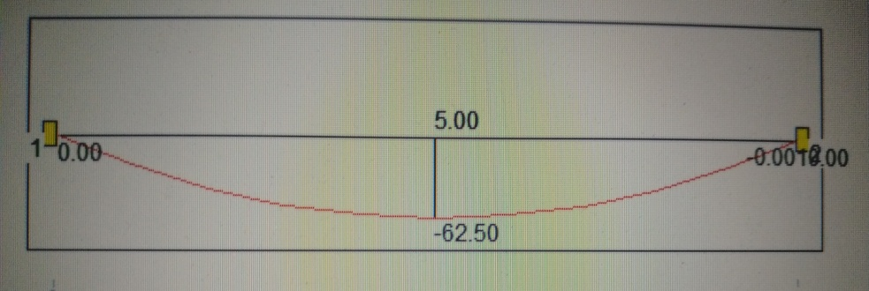
Output:
Shear force
Deflection
Bending
moment

Slide 24
BEAM DESIGN
After analyzing the beam, we can design the beam by going to “Design” option
Select material and respective code
Select Parameters => Define Parameters => Commands
Analysis/print => Analyze => Run Analysis
Post processing option→ to check the analysis results

Slide 25
Translational repeat→ to increase the storeys of the
building.
Report→ to write the report.
In geometry option “Run structure Wizard”.
It helps to get the prototype models like trusses,
frames, composite models etc.
Selection database→ to define properties to them
according to the required codes.

Slide 26

Example

Slide 27
Input:
Load= udl -5kN/m
Supports=both ends fixed
Length=10m
fck=40N/mm^2
Beam =300*600 mm

Slide 28
Output:
Shear force
Deflection
Bending
moment

Slide 29
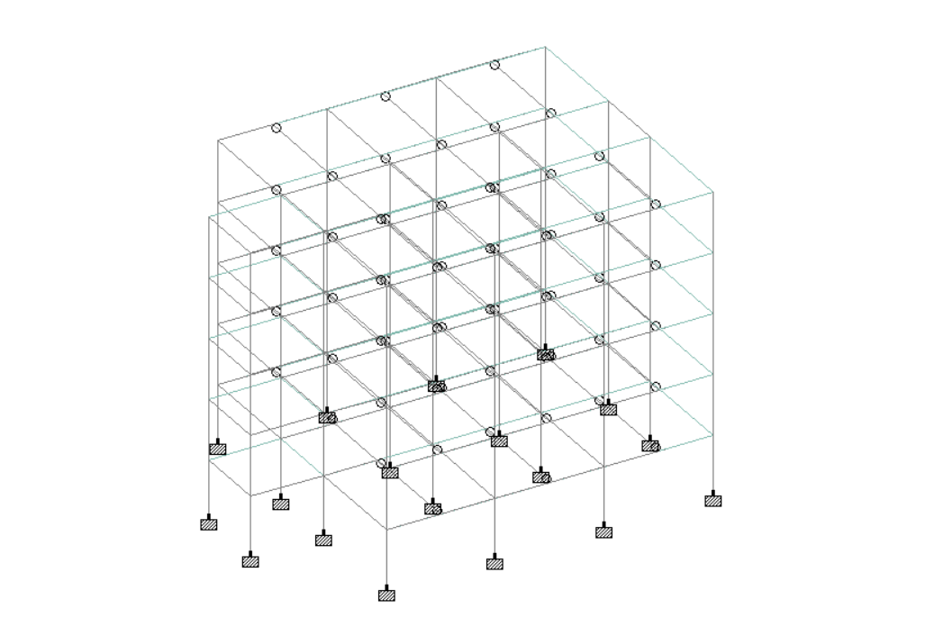
Project
We’ve built a G+3 RCC Building.

Slide 30
Procedure to Create a Project
PLACING NODES
CONNECTING BEAMS
TRANSLATIONAL REPEAT
APPLYING LOADS
ASSIGNING PROPERTIES AND MATERIAL
ASSIGNING SUPPORTS
ANALYZING

Slide 31
Structure Specifications
G+3 : DATA
Type of Structure : Multi-Storeyed Rigid Jointed Frame
No. Storeys : 4 – G+3
Floor to Floor Height : 3.35m
External Walls : 230mm
Internal Walls : 150mm
Bearing Capacity of Soil : 200N/mm^2

Slide 32
Input:
Imposed Load :
ROOF:
1. Roof Finish : 1.5 kN/mm^2
2. Live Load : 1.5 kN/mm^2
FLOOR:
1. Floor Finish : 1.0 kN/mm^2
2. Live Load : 4 kN/mm^2
MATERIAL:
Concrete M20 Grade
Steel Reinforcement Fe415
Unit Weight of Concrete = 25 kN/m^3
Unit Weight of Masonry = 20 kN/m^3

Slide 33
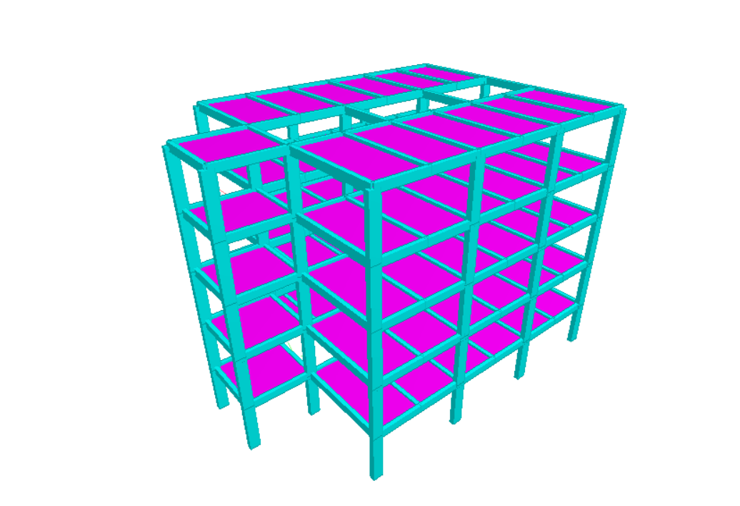
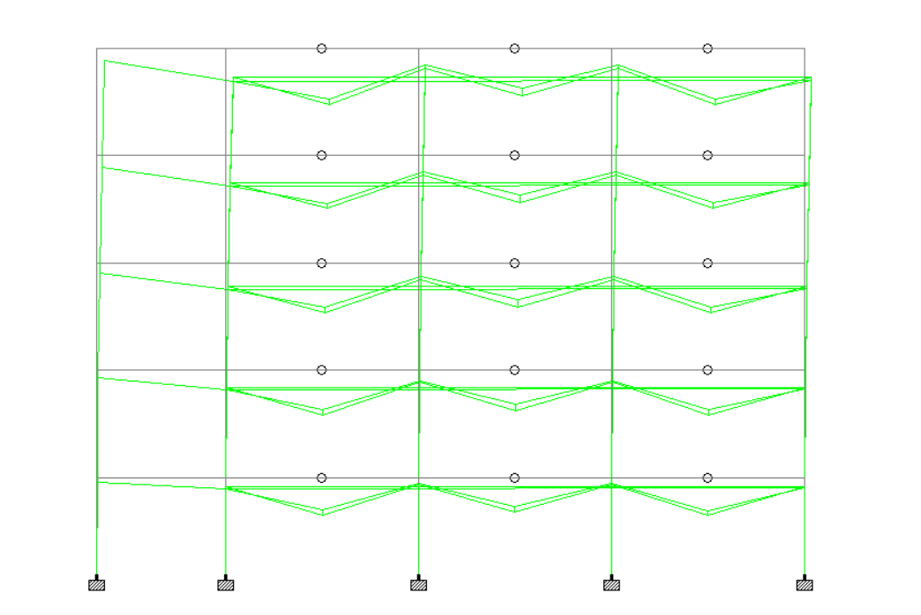
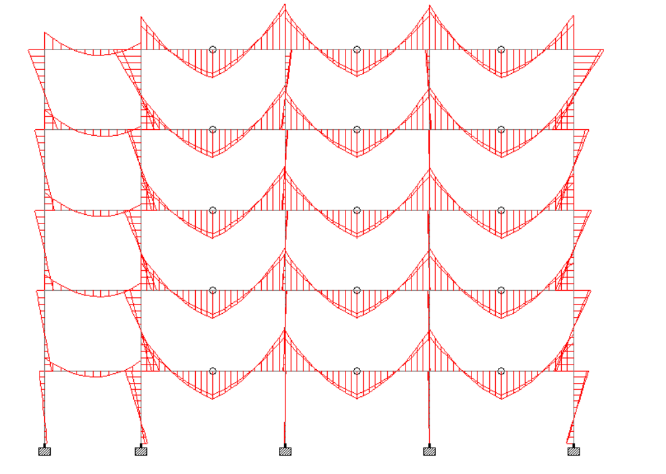
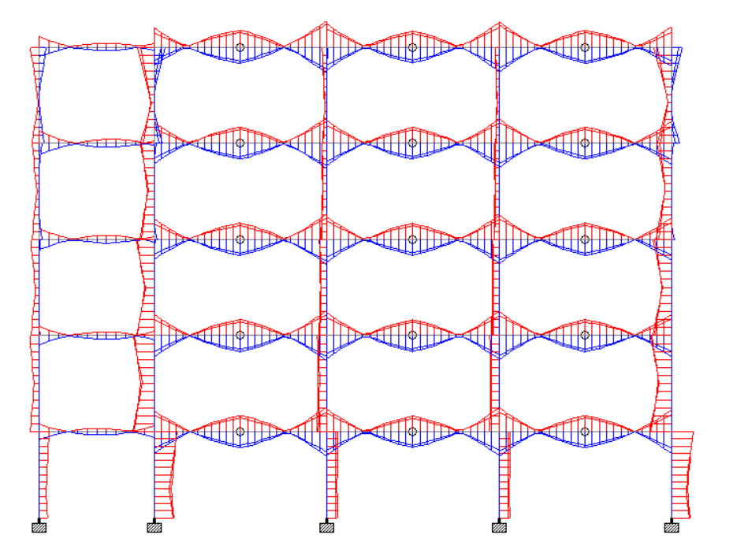
Post Processing
3D RENDERED VIEW
BEAM DISPLACEMENT
BMD
SFD

Slide 34
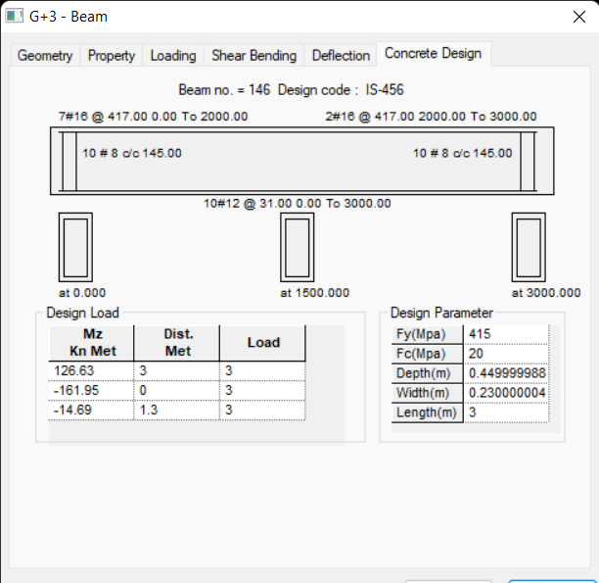
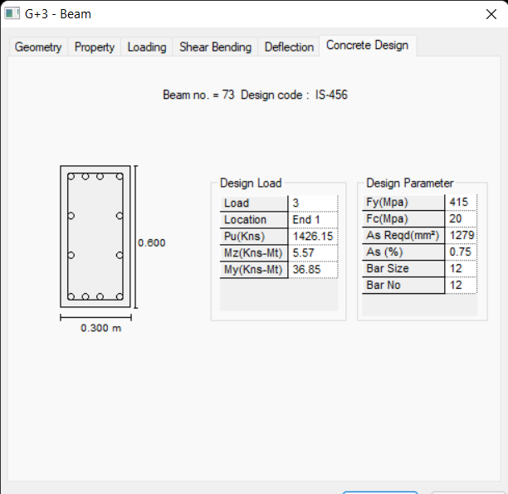
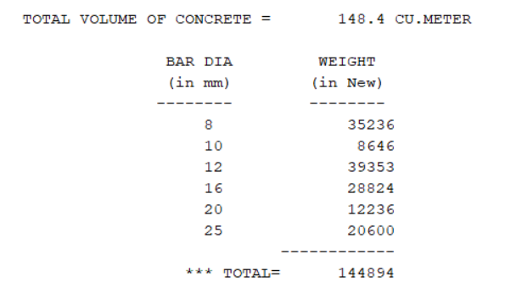

Slide 35
CONCLUSION
This project is mainly concentrated on the analysis and design of building using STAAD pro.
Also check the deflection.
In case of rectification, can simply change the values.
Less space required for storage.
Shear reinforcement is calculated.

Slide 36
Maximum sagging and hogging moments are calculated for each section.
Default design output of the beam contains flexural and shear reinforcement provided along the length of the beam.
All active load cases are tested to calculate the reinforcement.

Slide 37
Thank you

